Slide 1
MAZE GAME
Made by:
TAMAGHNA CHOUDHURI(REG NO.:962)
ANUSHTUP GANGULY(REG NO.:978)

Slide 2
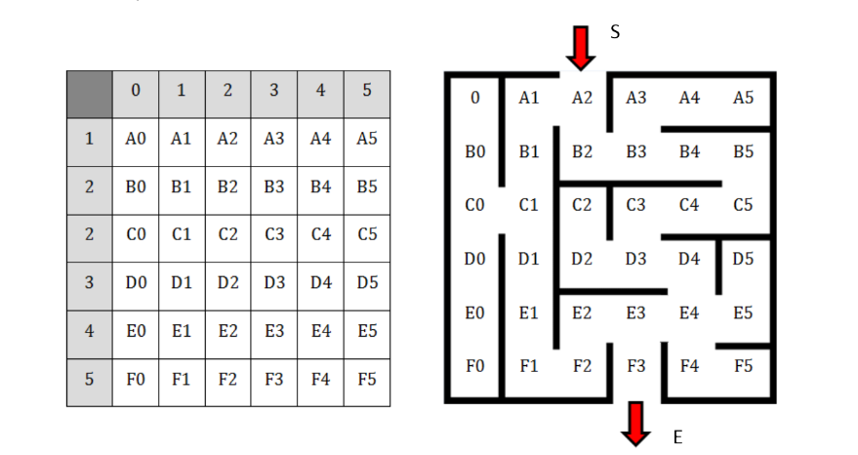
PROBLEM STATEMENT
A Maze is given as N*N binary matrix of blocks where source block is the upper left most block
i.e., maze[0][0] and destination block is lower rightmost block i.e., maze[N-1][N-1]. A rat starts
from source and has to reach the destination. The rat can move only in two directions: forward and
down. Write a program to simulate the game with a 6×6 maze as given below. Rat will start from
S (selected randomly in each game). In case of termination of movement before reaching the
destination (E), the rat will be allowed to return back to the previous position and take new move.
Your system will list down and display the movements of the rat (you can use file to write all
movements).

Slide 3
ALGORITHM
INTRODUCTION TO BACKTRACKING

Slide 4
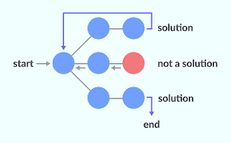
BACKTRACKING
Backtracking is an algorithmic strategy for iteratively solving a problem by eliminating options that never fulfill the restrictions of the issue and attempting to put together the answer piece by piece (time is here for any given search tree). is referred to be the elapsed time required to reach the level of The alternative to using brute force is backtracking. In essence, the backtracking approach seeks to solve a problem by exploring all potential solutions. If the chosen option did address the issue, it begins to go backward from the first potential choice and returns the answer. If not, go back and pick another one from the list of alternatives. None of the choices might offer a resolution. The amount of time required to get to a certain level, Backtracking is a better method than using raw force. Therefore, the backtracking technique's primary premise is to consider all of your alternatives in search of a solution to a problem. If the chosen option did fix the issue, it proceeds backward from there and delivers the answer. If not, go back and choose an alternative from the ones that are still available. There may not be a solution in any of the possibilities. I now realize that going backward won't help with this particular issue. Recursion also includes backtracking. This is due to the cyclical repetition of the process of selecting a solution from among the numerous alternatives until no solution is discovered or a final state is attained. We may then infer that by going backward at each stage, we eliminate possibilities that do not offer a solution and go forward with those that could.

Slide 5
How to determine if a problem can be solved using Backtracking?
Generally speaking, backtracking can be used to solve any constraint satisfaction problem that has clear and well-defined constraints on any objective solution, builds candidates incrementally towards the solution, and abandons a candidate once it realises that it cannot possibly be completed to a valid solution. However, the majority of the issues raised can be resolved using other well-known algorithms, such as Dynamic Programming or Greedy Algorithms, which are superior to the backtracking algorithm in every way and have logarithmic, linear, or linear-logarithmic time complexity, depending on the size of the input (since backtracking algorithms are generally exponential in both time and space). There are still certain issues, though, and up until now, backtracking algorithms have been the only way to fix them.Imagine that you have three boxes in front of you, but only one of them contains a gold coin, and you are unsure which one it is. You must thus open each box one at a time is order to obtain the coin. Close the first box after inspecting it if it's empty, then check the second box, and so on until you find the coin. Backtracking is the practice of addressing each minor issue independently in an effort to identify the best solution.

Slide 6
ALGORITHM
Recursion

Slide 7
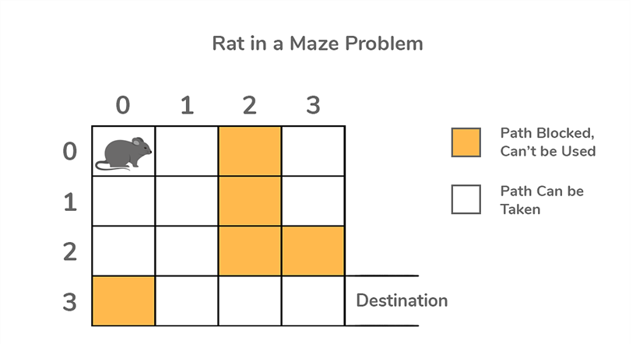
Recursion
Recursion is the technique of making a function call itself. This technique provides a way to break complicated problems down into simple problems which are easier to solve.
In this question we use recursion to build up the solution one step at a time and to determine whether we can find a solution or not.
We first check if the starting position has any valid moves,then we start by moving to the next valid position and do the same till we can determine if we can reach a solution or not.

Slide 8
LIMITATIONS
The solution to the maze problem with the implementation of backtracking has the following limitations:
As the backtracking algorithm requires a lot of space and the time complexity is very high the solution often requires high computational powers when the problem’s input data set becomes large.
The solution is limited to specific maze cases and cannot be implemented when the boxes have borders which are of the type both open and close.
Another limitation is thrashing, i.e., repeated failure due to the same reason. Thrashing occurs because the standard backtracking algorithm does not identify the real reason of the conflict, i.e., the conflicting variables. Therefore, search in different parts of the space keeps failing for the same reason. Thrashing can be avoided by intelligent backtracking, i.e., by a scheme on which backtracking is done directly to the variable that caused the failure.
The other drawback of backtracking is having to perform redundant work. Even if the conflicting values of variables is identified during the intelligent backtracking, they are not remembered for immediate detection of the same conflict in a subsequent computation.

Slide 9
Future scope
The solution of the rate and maze problem has its own limitation
To in the future the following can be corrected
The method of input can be changed
We can make it a full fledged game
As we couldn’t print the exact path ,we can try and do that in the next version
We can integrate greedy algorithms to give a the shortest path

